Slide 1


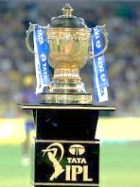
ANALYZING IPL DATA USING SQL
KUNUR ARCHANA - DATA SCIENCE STUDENT
kunurarchanagoud@gmail.com

Slide 2
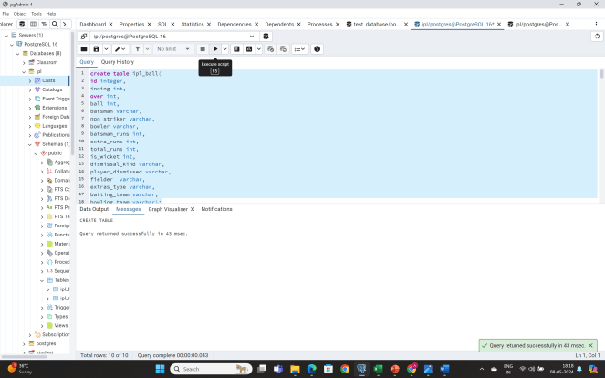
QUERY TO CREATE THE TABLE IPL_BALL
create table ipl_ball(
id integer,
inning int,
over int,
ball int,
batsman varchar,
non_striker varchar,
bowler varchar,
batsman_runs int,
extra_runs int,
total_runs int,
is_wicket int,
dismissal_kind varchar,
player_dismissed varchar,
fielder varchar,
extras_type varchar,
batting_team varchar,
bowling_team varchar);

Slide 3
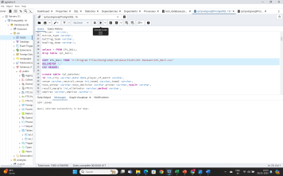
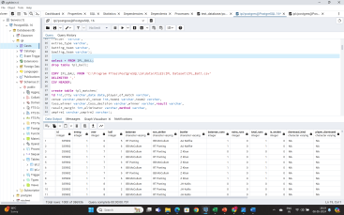
QUERY TO COPY THE DATA INTO TABLE FROM CSV FILE AND CHECK THE DATA IN TABLE
COPY IPL_BALL FROM 'C:\Program Files\PostgreSQL\16\data\FILES\IPL Dataset\IPL_Ball.csv'
DELIMITER ','
CSV HEADER;
select * From IPL_BALL;

Slide 4
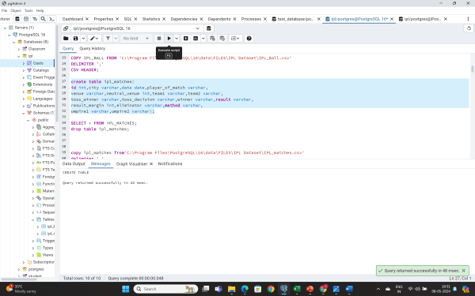
QUERY TO CREATE THE TABLE IPL_MATCHES
create table ipl_matches(
id int,
city varchar,
date date,
player_of_match varchar,
venue varchar,
neutral_venue int,
team1 varchar,
team2 varchar,
toss_winner varchar,
toss_decision varchar,
winner varchar,
result varchar,
result_margin int,
eliminator varchar,
method varchar,
umpire1 varchar,
umpire2 varchar);

Slide 5
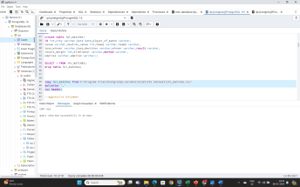
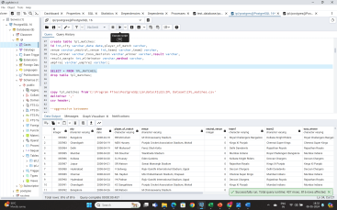
Query to copy the data into table from csv file and check the data in table
copy ipl_matches from'C:\Program Files\PostgreSQL\16\data\FILES\IPL Dataset\IPL_matches.csv'
delimiter ','
csv header;
SELECT * From IPL_MATCHES;

Slide 6
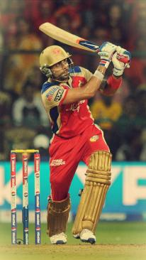
TASK-1 Query to get the top 10 Aggressive Batsman with high Strike Rate
select *
from (select batsman,
sum(batsman_runs) as total_runs_scored,
count(ball) as balls_faced,
(sum(batsman_runs)::decimal/count(ball))*100 as strike_rate
from ipl_ball
where extras_type!='wides'
group by batsman) as a
where a.balls_faced>=500
order by a.strike_rate desc
limit 10;

Slide 7
These are the top 10 batsman with highest strike rate who has faced atleast 500 balls. AD RUSSELL And SP NARINE are at the top of the table with leading strike rate
The resultant table for above query.
Batsman | Total runs Scored | Balls faced | Strike Rate
AD Russell | 1517 | 832 | 182.3317
SP Narine | 892 | 543 | 164.2726
HH Pandya | 1349 | 847 | 159.268
V Sehwag | 2728 | 1755 | 155.4416
GJ Maxwell | 1505 | 973 | 154.6763
RR Pant | 2079 | 1368 | 151.9737
AB de Villiers | 4849 | 3192 | 151.911
CH Gayle | 4772 | 3179 | 150.1101
KA Pollard | 3023 | 2017 | 149.8761
JC Buttler | 1714 | 1146 | 149.5637

Slide 9
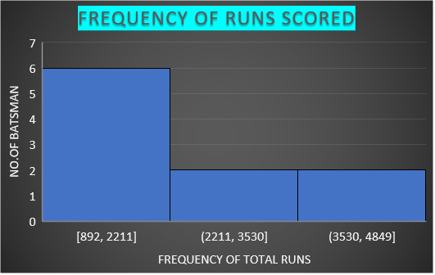

Slide 10
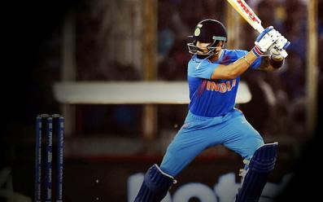
Task 2 – query to get the top 10 anchor batsmen with good average and played 2 seasons
select * from
(select a.batsman,
sum(a.batsman_runs) as total_runs,
sum(a.is_wicket) as no_of_times_dimissed,
count(distinct(extract(year from b.date))) as season,
(sum(a.batsman_runs)*1.0/sum(a.is_wicket)) as average
from ipl_ball as a
left join ipl_matches as b
on a.id=b.id
group by a.batsman ) as d
where d.season>2
order by d.average desc
limit 10;

Slide 11
The resultant table for above query. These are the top 10 batsmen with good average and played atleast 2 seasons IQBAL ABDULLA has the highest average and played 8 seasons in ipl.
Batsman | Total runs | Number of times dimissed | Season | Average
Iqbal Abdulla | 264 | 3 | 8 | 88
KL Rahul | 7941 | 186 | 7 | 42.69355
AB de Villiers | 14547 | 342 | 13 | 42.53509
DA Warner | 15762 | 378 | 11 | 41.69841
JP Duminy | 6087 | 147 | 8 | 41.40816
CH Gayle | 14316 | 348 | 12 | 41.13793
ML Hayden | 3321 | 81 | 3 | 41
LMP Simmons | 3237 | 81 | 4 | 39.96296
KS Williamson | 4857 | 123 | 6 | 39.4878
OA Shah | 1518 | 39 | 4 | 38.92308

Slide 12
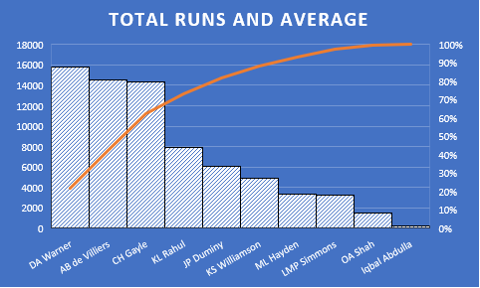

Slide 13
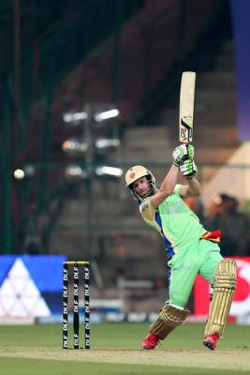
TASK 3- QUERY TO GET TOP 10 HARD-HITTING BATSMAN WHO SCORED MORE RUNS IN BOUNDARIES AND PLAYED 2 IPL SEASONS
select * from
( select a.batsman,
sum(a.batsman_runs) as batsman_total_runs,
sum(a.total_runs) as total_runs,
count(distinct(extract(year from b.date))) as season,
(sum(case when total_runs >=4 then batsman_runs else 0 end)* 100/sum(batsman_runs)*1.0) as boundary_percentage
from ipl_ball as a
left join ipl_matches as b
on a.id=b.id
group by a.batsman) as d
where d.season>2
order by d.boundary_percentage desc
limit 10;
This Photo by Unknown Author is licensed under CC BY-SA-NC

Slide 14
THE RESULTANT RABLE OF ABOVE QUERY These are the top 10 Anchor Batsman who have most runs in boundaries and played atleast 2 seasons SP NARINE,AD RUSSELL are at the top of the table.
Batsman | Batsman Total Runs | Total Runs | Season | Boundary Percentage
SP Narine | 2676 | 2877 | 9 | 81
AD Russell | 4551 | 4812 | 8 | 78
CH Gayle | 14316 | 15309 | 12 | 76
CR Brathwaite | 543 | 594 | 4 | 75
ST Jayasuriya | 2304 | 2529 | 3 | 74
BCJ Cutting | 714 | 753 | 5 | 73
MS Gony | 297 | 318 | 6 | 72
KK Cooper | 348 | 366 | 3 | 72
AC Gilchrist | 6207 | 6645 | 6 | 72
MJ McClenaghan | 255 | 276 | 5 | 72

Slide 15


Slide 17

Task 4- query to get the top 10 economical bowlers with good economy and bowled atleast 500 balls in ipl
select * from
(select bowler,
sum(total_runs) as total_runs_given,
(count(over)/6) as total_over_bowled,
count(ball) as total_balls,
(sum(total_runs*1.0)/(count(over)/6)) as economy
from ipl_ball
group by bowler) as a
where a.total_balls>=500
order by a.economy desc
limit 10;
This Photo by Unknown Author is licensed under CC BY-SA-NC

Slide 18
THE RESULTANT TABLE FOR THE ABOVE QUERY These are the top 10 Economical bowlers who has good economy and bowled atleast 500 balls in IPL.
Bowler | Total Runs Given | Total Over Bowled | Total Balls | Economy
TK Curran | 984 | 90 | 540 | 10.93333
CJ Anderson | 1575 | 157 | 945 | 10.03185
Avesh Khan | 903 | 92 | 555 | 9.815217
Basil Thampi | 2112 | 218 | 1311 | 9.688073
B Laughlin | 852 | 89 | 537 | 9.573034
I Udana | 858 | 91 | 546 | 9.428571
KC Cariappa | 1047 | 112 | 672 | 9.348214
Mohammad Asif | 921 | 99 | 597 | 9.30303
Kartik Tyagi | 1116 | 120 | 723 | 9.3
Joginder Sharma | 1263 | 136 | 816 | 9.286765

Slide 20

Task 5- query to get the top 10 wicket-taking bowlers with good strike rate and bowled atlest 500 balls in ipl
select bowler,
count(ball) as total_balls_bowled,
sum(is_wicket) as total_wicket_taken,
((count(ball)*1.0)/sum(is_wicket)) as strike_rate
from ipl_ball
where not dismissal_kind in('run out','retired hurt','obstructing the field')
group by bowler
having count(ball)>500
order by strike_rate desc
limit 10;
This Photo by Unknown Author is licensed under CC BY-NC-ND

Slide 21
THE RESULTANT TABLE FOR THE ABOVE QUERY. These are the top 10 Wicket-Taking bowlers with good Strike Rate and bowled atleast 500 balls in IPL.
Bowler | Total Balls Bowled | Total Wicket taken | Strike Rate
V Kohli | 789 | 12 | 65.75
TM Dilshan | 825 | 15 | 55
Parvez Rasool | 600 | 12 | 50
J Yadav | 804 | 18 | 44.66667
A Mithun | 933 | 21 | 44.42857
DJ Hussey | 963 | 24 | 40.125
C de Grandhomme | 687 | 18 | 38.16667
M Kartik | 3522 | 93 | 37.87097
Avesh Khan | 555 | 15 | 37
SK Raina | 2775 | 75 | 37

Slide 22
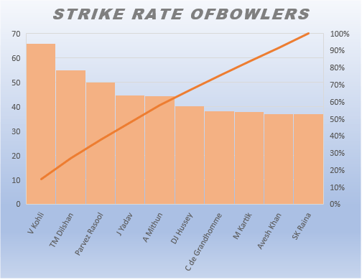

Slide 23
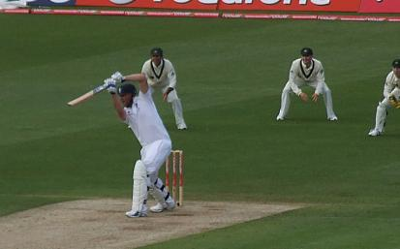
Task 6-query to get the top 10 all rounders with best batting as well as bowling strike rate who has faced atleast 500 balls and bowled minimum 300 balls in ipl
select a.*,b.* from
(select batsman as player,
sum(batsman_runs) as total_runs_scored,
count(ball) as balls_faced,
(sum(batsman_runs)::decimal/count(ball))*100
as batting_strike_rate
from ipl_ball
where extras_type!='wides'
group by batsman having count(ball)>=500
order by batting_strike_rate desc) as a
inner join (select bowler as player,
count(ball) as total_balls_bowled,
sum(is_wicket) as total_wicket_taken,
((count(ball)*1.0)/sum(is_wicket)) as bowling_strike_rate
from ipl_ball
where not dismissal_kind in('run out','retired hurt','obstructing the field')
group by bowler having count(ball)>300 order by bowling_strike_rate desc) as b
on a.player=b.player
order by batting_strike_rate desc,
bowling_strike_rate desc limit 10;
This Photo by Unknown Author is licensed under CC BY-SA

Slide 24
THE RESULTANT TABLE FOR THE ABOVE QUERY. These are the top 10 All Rounders with good batting and bowling strike rate and face atleast 500 balls and bowled minimum 300 balls in IPL.
Player | Totalruns Scored | Balls Faced | Batting StrikeRate | Player-2 | Total Balls Bowled | Total Wicket Taken | Bowling Strike Rate
AD Russell | 4551 | 2496 | 182.3317 | AD Russell | 3540 | 183 | 19.34426
SP Narine | 2676 | 1629 | 164.2726 | SP Narine | 8424 | 381 | 22.11024
HH Pandya | 4047 | 2541 | 159.268 | HH Pandya | 2733 | 126 | 21.69048
MM Ali | 927 | 585 | 158.4615 | MM Ali | 780 | 30 | 26
CH Morris | 1653 | 1047 | 157.8797 | CH Morris | 4572 | 240 | 19.05
V Sehwag | 8184 | 5265 | 155.4416 | V Sehwag | 414 | 18 | 23
GJ Maxwell | 4515 | 2919 | 154.6763 | GJ Maxwell | 1671 | 57 | 29.31579
CH Gayle | 14316 | 9537 | 150.1101 | CH Gayle | 1749 | 54 | 32.38889
KA Pollard | 9069 | 6051 | 149.8761 | KA Pollard | 4209 | 180 | 23.38333
A Ashish Reddy | 840 | 579 | 145.0777 | A Ashish Reddy | 807 | 54 | 14.94444

Slide 27
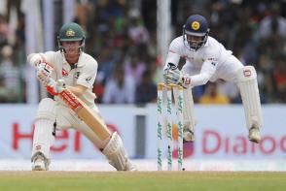
TASK 7-WICKET KEEEPER CRITERIA
In T20 cricket , wicket keeper are key player in the team. The wicket keeper is the player from fielding side who stands behind the wicket and always ready to stump the ball to wickets , catches the ball or to runout the player to eliminate the batsman from the game.As we know that runout is team work ,so here we count the number of caughts and stumps.
To Identify the best wicket keeper ,we need to find the player who has ticken most wickets(stumps,run out and catches) and played atleast 2 ipl seasons. To do that ,we need to filter the fielder column with the condition that is_wicket is equal to 1 and dismissal kind is stumped or caught or run out and have played more than 2 ipl seasons. This criteria allows us to get the wicketkeepers from fielders column because wicketkeeper is involved specially in stumping the ball to wicket to eliminate a batter.
This Photo by Unknown Author is licensed under CC BY-NC-ND

Slide 28
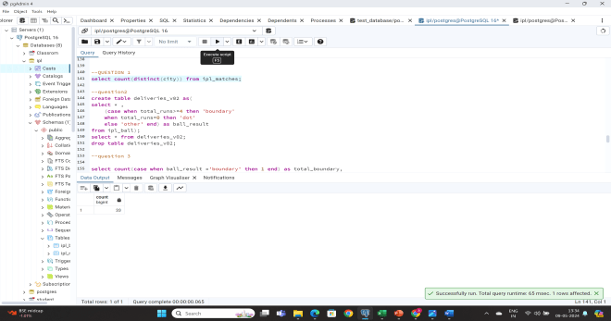
ADDITIONAL QUESTION -1
select count(distinct(city)) from ipl_matches;

Slide 29
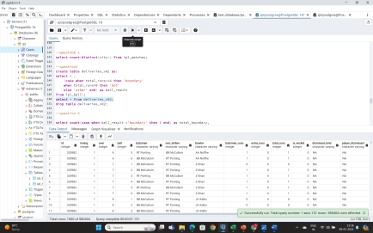
ADDITIONAL QUESTION 2
create table deliveries_v02 as(
select * ,
(case when total_runs>=4 then 'boundary'
when total_runs=0 then 'dot'
else 'other' end) as ball_result
from ipl_ball);

Slide 30
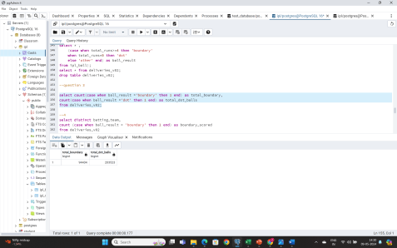
ADDITIONAL QUESTION-3
select count(case when ball_result ='boundary' then 1 end) as total_boundary,
count(case when ball_result ='dot' then 1 end) as total_dot_balls
from deliveries_v02;

Slide 31
TOTAL BOUNDARY | TOTAL DOTS
94404 | 203523

Slide 32
ADDITIONAL QUESTION-4
Batting Team | BoundaryScored
Mumbai Indians | 12354
Royal Challengers Bangalore | 11400
Kings XI Punjab | 11340
Kolkata Knight Riders | 11217
Chennai Super Kings | 10488
Rajasthan Royals | 9123
Delhi Daredevils | 9066
Sunrisers Hyderabad | 6918
Deccan Chargers | 4161
Pune Warriors | 2199
Delhi Capitals | 1977
Gujarat Lions | 1872
Rising Pune Supergiant | 870
Rising Pune Supergiants | 726
Kochi Tuskers Kerala | 693
select distinct batting_team,
count (case when ball_result = 'boundary' then 1 end) as boundary_scored
from deliveries_v02
group by batting_team
order by boundary_scored desc;

Slide 33


Slide 34
ADDITIONAL QUESTION -5
Bowling Team | Number of Dot Balls
Mumbai Indians | 26142
Royal Challengers Bangalore | 23865
Kolkata Knight Riders | 23682
Kings XI Punjab | 23037
Chennai Super Kings | 22779
Rajasthan Royals | 19995
Delhi Daredevils | 19560
Sunrisers Hyderabad | 15744
Deccan Chargers | 9918
Pune Warriors | 5700
Delhi Capitals | 4014
Gujarat Lions | 3285
Rising Pune Supergiant | 2094
Kochi Tuskers Kerala | 1878
Rising Pune Supergiants | 1617
NA | 213
select distinct bowling_team,
count(case when ball_result = 'dot' then 1 end) as
No_of_dot_balls
from deliveries_v02
group by bowling_team
order by No_of_dot_balls desc;

Slide 35


Slide 36
ADDITIONAL QUESTION -6
select DISTINCT DISMISSAL_KIND, count(case when dismissal_kind != 'NA' then 1 end) as total_dismissal
from deliveries_v02
Group By DISMISSAL_KIND;
Dismissal Kind | Total Dismissal
bowled | 5100
caught | 17229
caught and bowled | 807
hit wicket | 36
lbw | 1713
NA | 0
obstructing the field | 6
retired hurt | 33
run out | 2679
stumped | 882

Slide 37
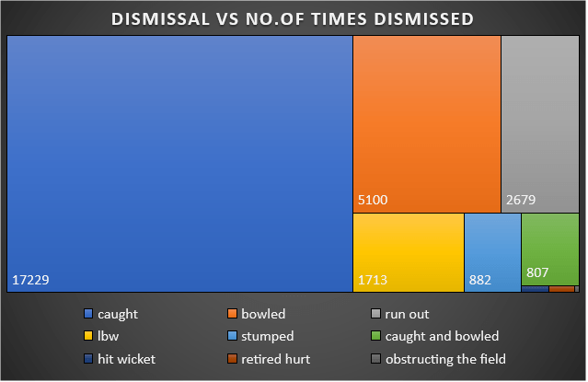

Slide 38
ADDITIONAL QUESTION-7
select bowler,sum(extra_runs) as max_extra_runs from deliveries_v02
group by bowler
order by max_extra_runs desc
limit 5;
Bowler | Max Extra Runs
SL Malinga | 879
P Kumar | 708
UT Yadav | 678
DJ Bravo | 630
B Kumar | 603

Slide 40
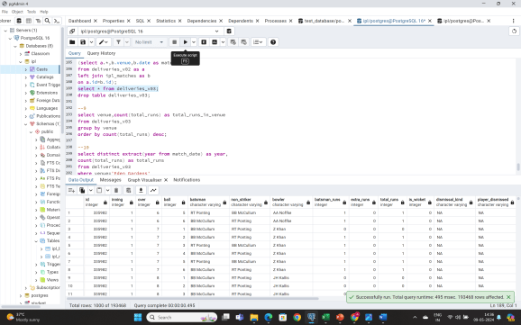
ADDITIONAL QUESTION-8
create table deliveries_v03 as
(select a.*,b.venue,b.date as match_date
from deliveries_v02 as a
left join ipl_matches as b
on a.id=b.id);
select * from deliveries_v03;

Slide 41
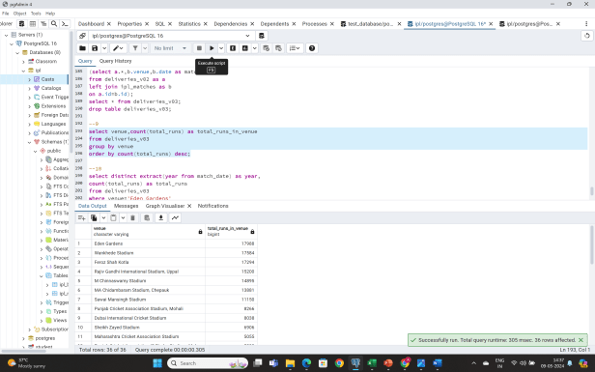
ADDITIONAL QUESTION-9
select venue,count(total_runs) as total_runs_in_venue
from deliveries_v03
group by venue
order by count(total_runs) desc;

Slide 43
ADDITIONAL QUESTION-10
Year | Total Runs
2018 | 2082
2013 | 1929
2019 | 1720
2015 | 1706
2010 | 1681
2012 | 1620
2017 | 1608
2011 | 1586
2008 | 1565
2016 | 1553
2014 | 938
select distinct extract(year from match_date) as year,
count(total_runs) as total_runs
from deliveries_v03
where venue='Eden Gardens'
group by year
order by count(total_runs) desc;

Slide 45
THANK YOU

